Slide 1
Trade Processing – Fixed Income

Slide 2
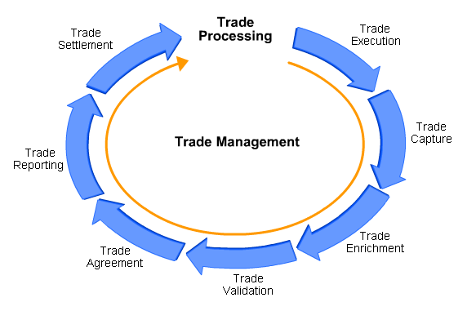
Introduction
Trade Processing constitutes of a step by step approach towards efficient management of trade throughout its lifecycle. Throughout the trade life cycle, there are a number of ongoing position and trade-related functions such as funding, reconciliation and corporate action that must be carried out.

Slide 3
Objectives On completion of this tutorial, you will be able to: - describe the different ways in which fixed income trades can be executed in the market - recognize the requirement for fixed income trades to be enriched and validated prior to settlement - explain the methods by which trade agreement can be reached between fixed income trading parties - describe how a fixed income trade is settled on the value date and the implications of settlement failure - recognize the need for ongoing position and trade management in relation to fixed income trading
Tutorial Overview A fixed income security is an investment that provides a return to investors in the form of periodic interest (coupon) payments and eventual return of the principal upon maturity. This tutorial focuses on the processing of fixed income trades and examines the key aspects of the trade lifecycle from trade execution right through to ongoing position and trade management tasks.

Slide 4
Trade Execution & Capture

Slide 5
Classification of Fixed Income Securities
Fixed Income Securities can be classified as follows:
Maturity
Groups
Static data

Slide 6
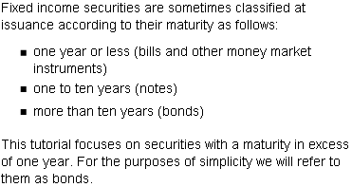
Maturity

Slide 7
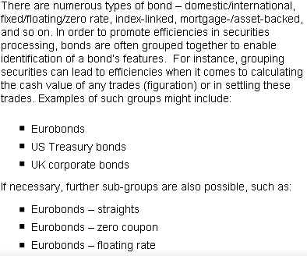
Groups

Slide 8
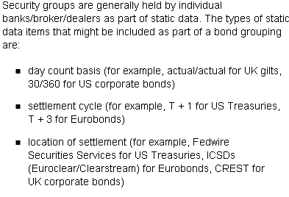
Static data

Slide 9
Types of Orders
The trade life cycle begins with an order to buy or sell a bond. There are several types of orders that bond investors can place:
Market orders
Limit orders
Stop orders
Stop-limit orders
Day orders
Good-till-cancelled (GTC) orders
Fill-or-kill (FOK) orders

Slide 10
Market orders

Slide 11
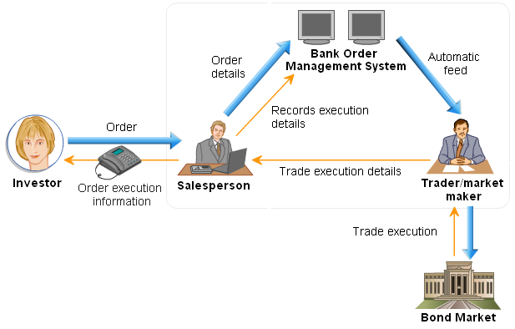
Trade Execution – Order Flow

Slide 12

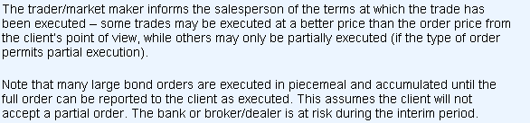
Steps

Slide 13
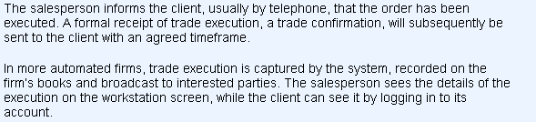

Contd..

Slide 14
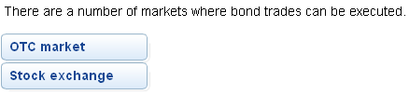
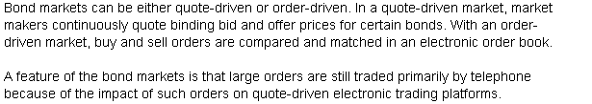
Markets

Slide 15
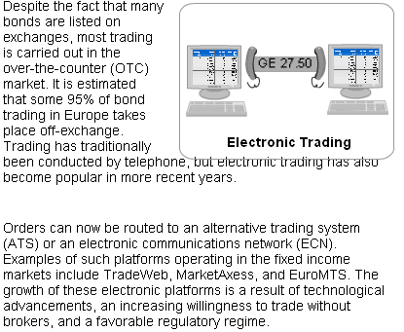
OTC Market

Slide 16
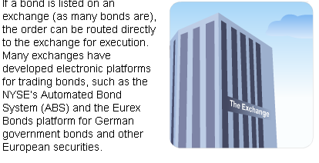
Stock Exchange

Slide 17

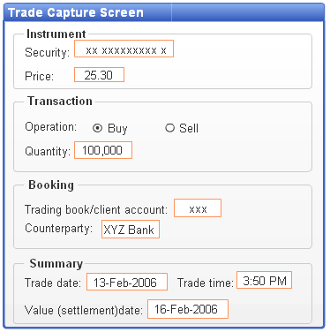
Trade Capture
The details typically include the following:

